Slide 1
Sequence comparison

Slide 2
Types of mutations
Insertions
Deletions
Mutations
Frameshift

Slide 3
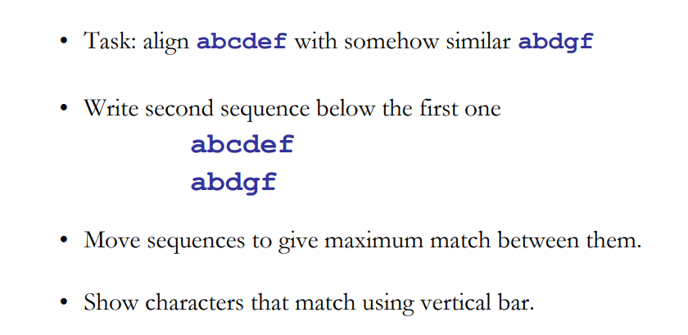
Sequence alignment

Slide 4
BLAST Saccharomyces and Staphylococcus aureus Dihydrofolate reductase
Score?

Slide 5
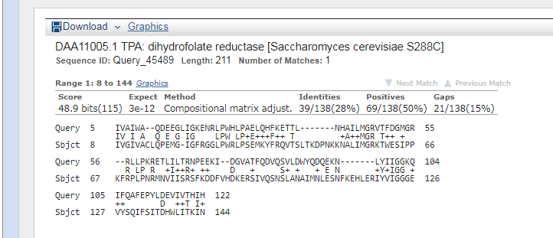
BLAST result- Yet they perform same function

Slide 6
Similarity versus Identity
Identity
Identity defines the percentage of amino acids (or nucleotides) with a direct match in the alignment.
Similarity (aka Positives)
When one amino acid is mutated to a similar residue such that the physiochemical properties are preserved, a conservative substitution is said to have occurred.
For example, a change from arginine to lysine maintains the +1 positive charge. This is far more likely to be acceptable since the two residues are similar in property and won't compromise the translated protein. Thus, percent similarity of two sequences is the sum of both identical and similar matches (residues that have undergone conservative substitution). Similarity measurements are dependent on the criteria of how two amino acid residues are to each other.

Slide 7
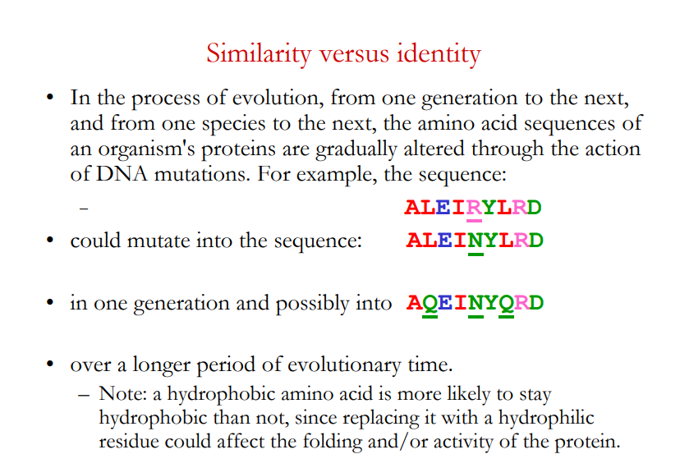
http://www.cs.otago.ac.nz/cosc348/alignments/Lecture05_GlobalAlignment.pdf

Slide 8
Sequence alignment- definitions
• Sequence alignment is a way of arranging two or more sequences of characters to identify regions of similarity
– b/c similarities may be a consequence of functional or evolutionary relationships between these sequences.
• Another definition: Procedure for comparing two or more sequences by searching for a series of individual characters that are in the same order in those sequences
– Pair-wise alignment: compare two sequences
– Multiple sequence alignment: compare > 2 sequences

Slide 9
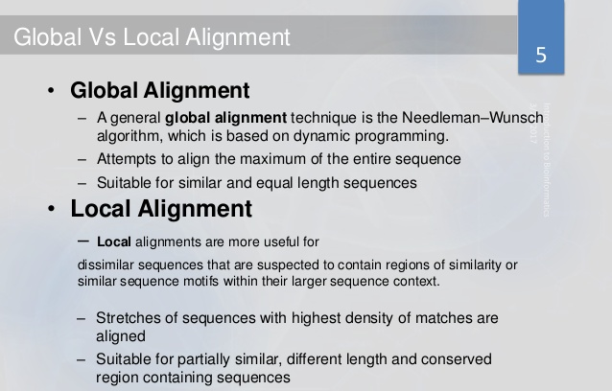
Adapted from slidesare
Notes:
9

Slide 10
Compare the following sequences
A b c d e f g h
B c d f g h I j
A b c d e f g h klmnp
B c d klmnp q v s I j fhgbns
A b c d e f g h klmnp
B c d klmnp f g h I j
How would you score this?
What will be your algorithm?

Slide 11
Dynamic Programming
Dynamic Programming is a method for solving a complex problem by breaking it down into a collection of simpler subproblems, solving each of those subproblems just once, and storing their solutions using a memory-based data structure (array, map,etc).
Needleman-Wunsch algorithm – for global alignment
Smith-Waterman algorithm – for local alignment

Slide 12
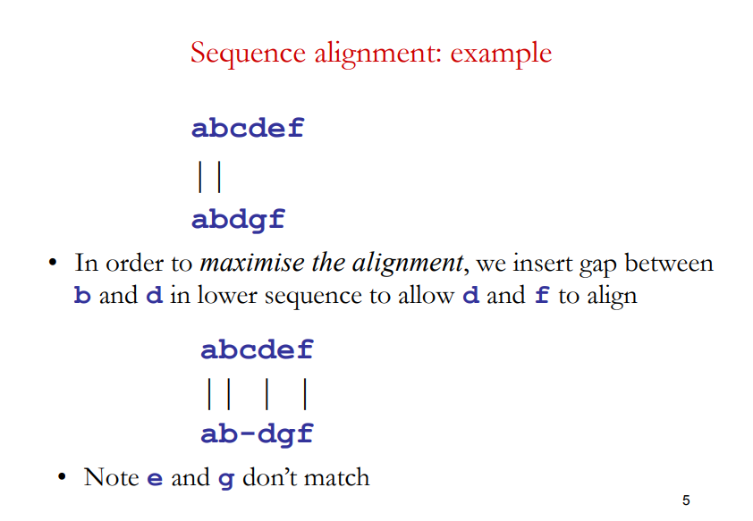
Sequence alignmentexample

Slide 13
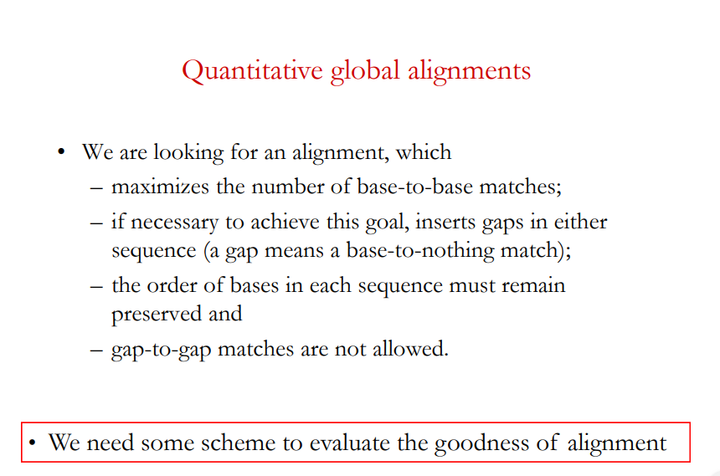

Slide 14
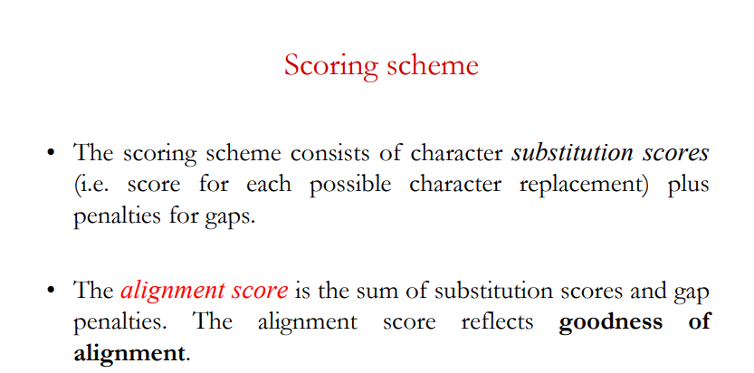
If we have identical matches, you can have a positive definite score. What about similarity? Can you substitute a base or an amino acid in tis position? For this we need a scoring matrix. It is the substitution matrix.

Slide 15
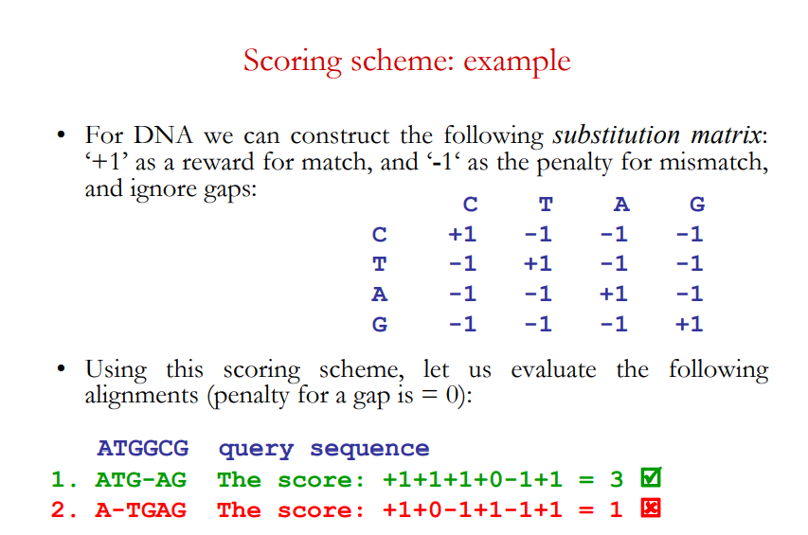
First let us consider DNA- 4 letters
A simple scoring scheme-
For matches= +1
For mismatches =-1
For gaps = 0
ATGCG versus ATGAG

Slide 16
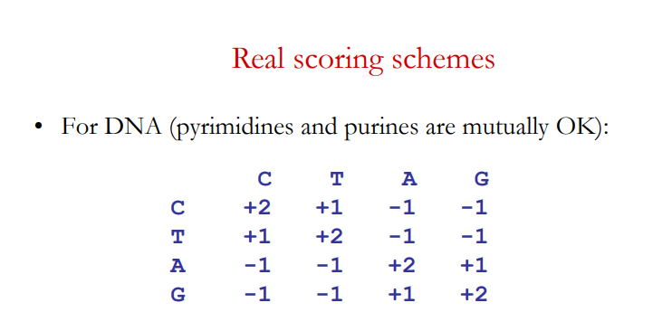
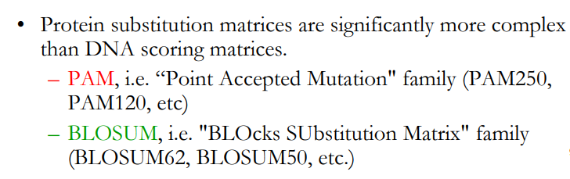
Can accommodate for similarities
A real scoring scheme-
For matches= +2
Positives= +1
For mismatches =-1
For gaps = 0

Slide 17
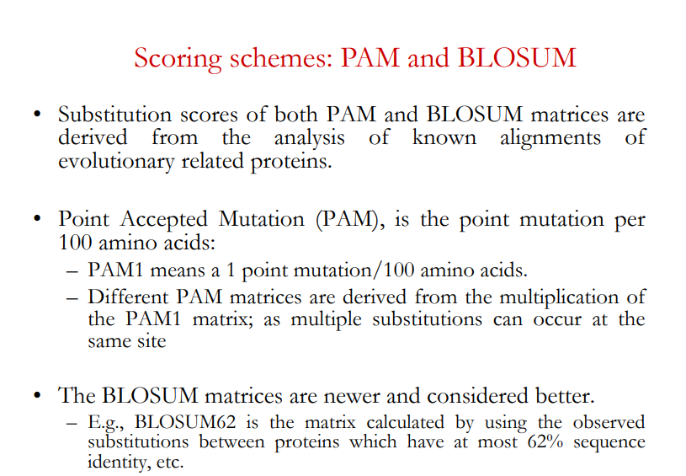

Slide 18
Scoring matrices
PAM Matrices: Margaret Dayhoff was the first one to develop the PAM matrix, PAM stands for Point Accepted Mutations. PAM matrices are calculated by observing the differences in closely related proteins. One PAM unit (PAM1) specifies one accepted point mutation per 100 amino acid residues, i.e. 1% change and 99% remains as such.
BLOSUM: BLOcks SUbstitution Matrix, developed by Henikoff and Henikoff in 1992, used conserved regions. These matrices are actual percentage identity values. Simply to say, they depend on similarity. Blosum 62 means there is 62 % similarity

Slide 19
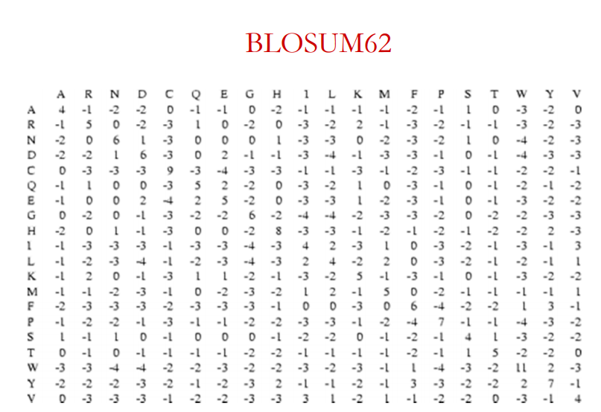

Slide 20
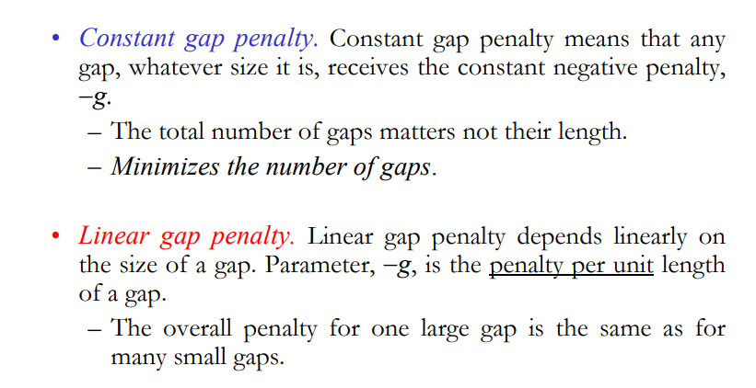
Different gap penalties and or gap extensions
Consider this
A T G - - - T C
A T G A G T T C
A T G - - T - C
A T G A G T T C

Slide 21
Gap score or gap penalty:
Dynamic programming algorithms use gap penalties to maximize the biological meaning. Gap penalty is subtracted for each gap that has been introduced. There are different gap penalties such as gap open and gap extension. The gap score defines a penalty given to alignment when we have insertion or deletion. During the evolution, there may be a case where we can see continuous gaps all along the sequence, so the linear gap penalty would not be appropriate for the alignment. Thus gap open and gap extension has been introduced when there are continuous gaps (five or more). The open penalty is always applied at the start of the gap, and then the other gaps following it is given with a gap extension penalty which will be less compared to the open penalty. Typical values are –12 for gap opening, and –4 for gap extension.

Slide 22
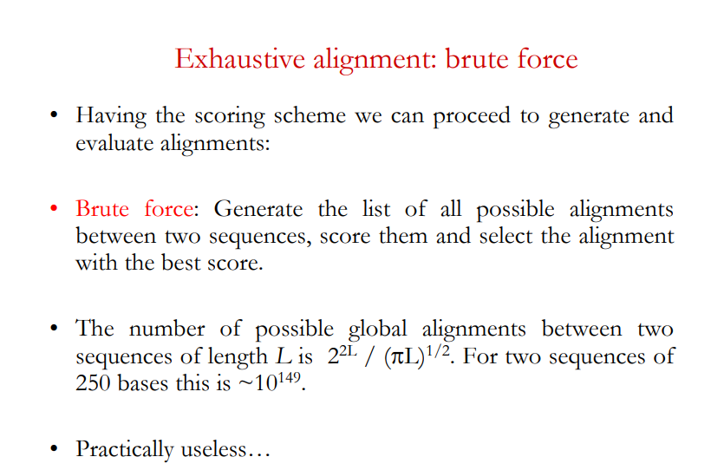

Slide 23
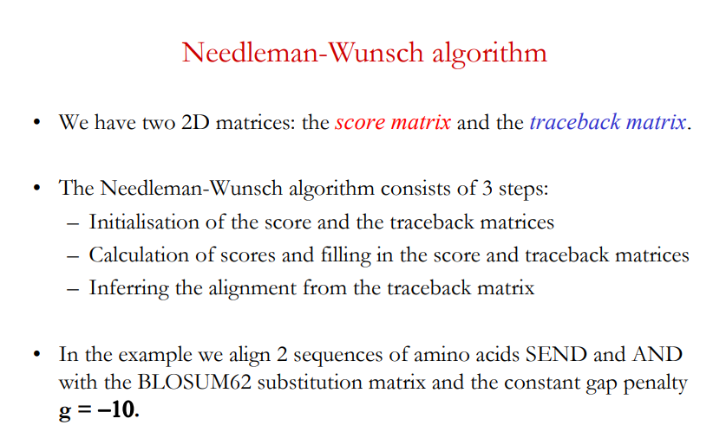

Slide 24
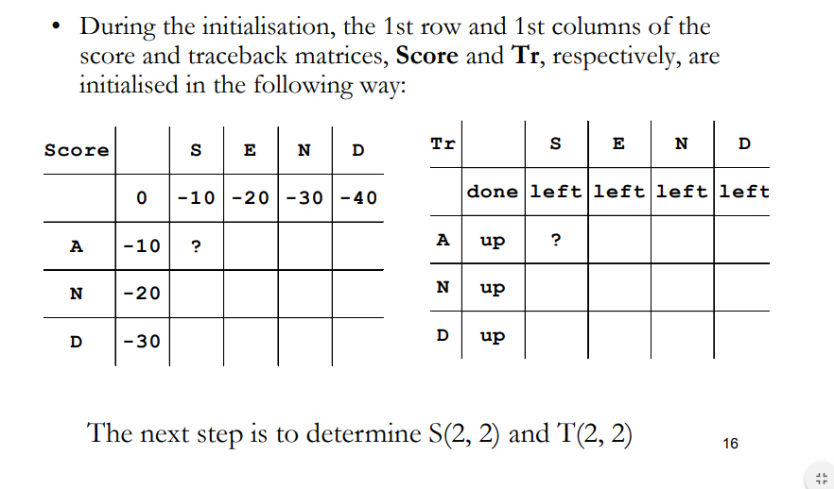
Step 1: Initialization

Slide 25
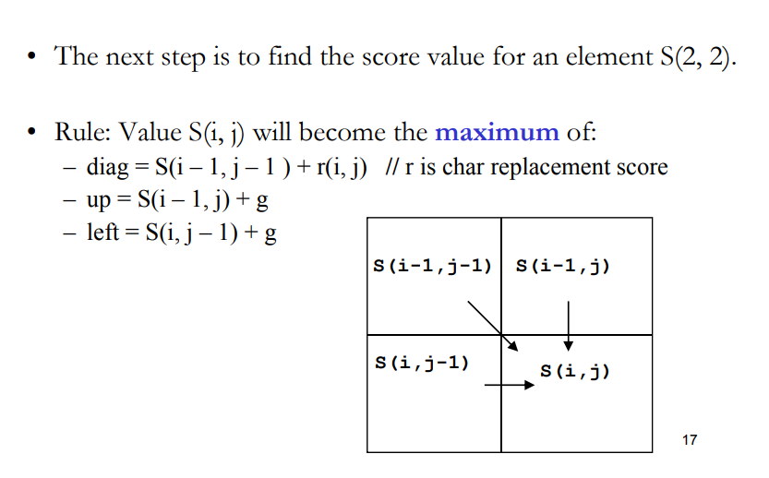
Step 2: Calculation of scores

Slide 26
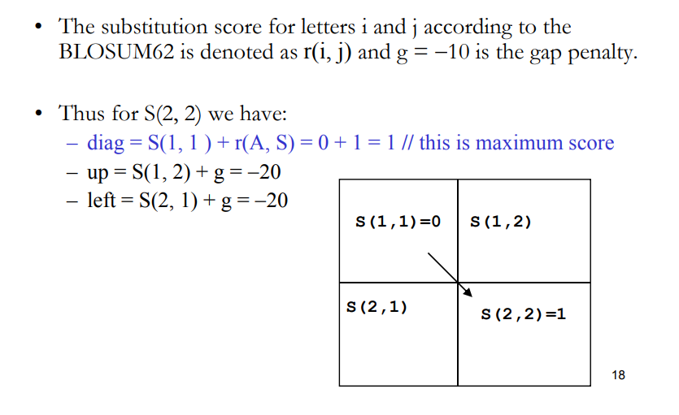
Step 2: Calculation of scores

Slide 27
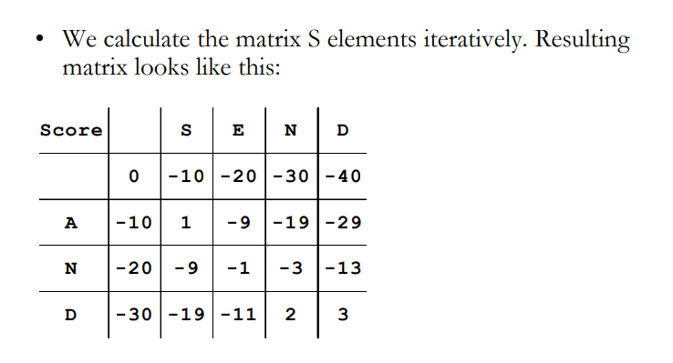
Step 2: Calculation of scores and filling in the score matrix

Slide 28
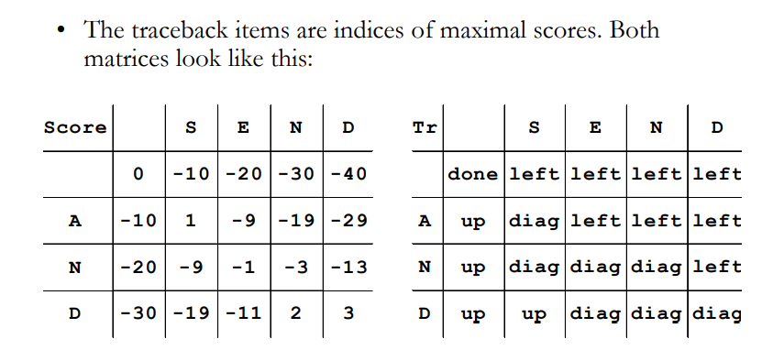
Step 2: Calculation of scores and filling in the traceback matrix

Slide 29
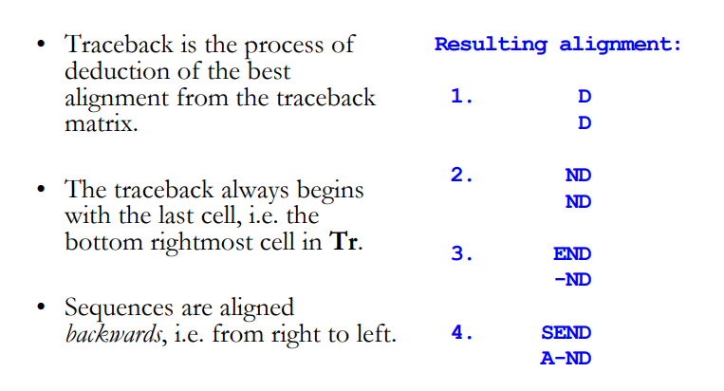
Step 3: Deducing the alignment

Slide 30
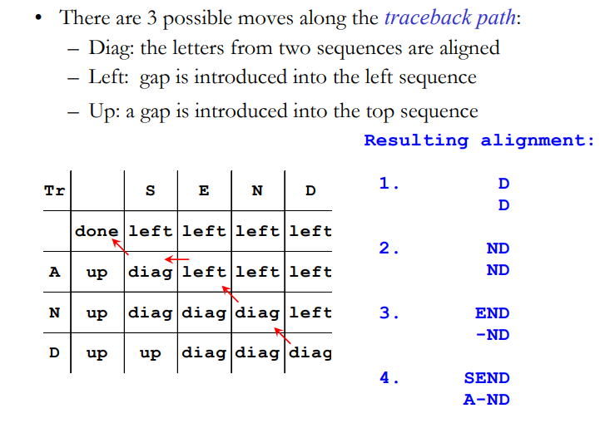
Step 3: Deducing the alignment

Slide 31
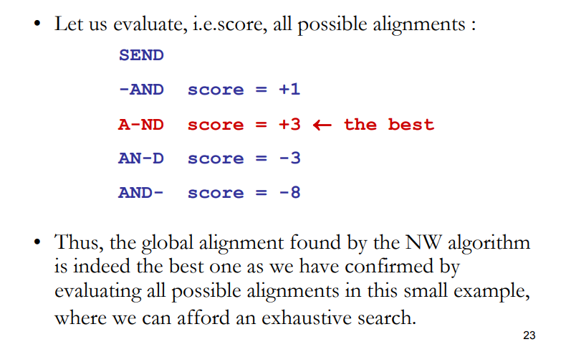
Evaluation of the alignment

Slide 32
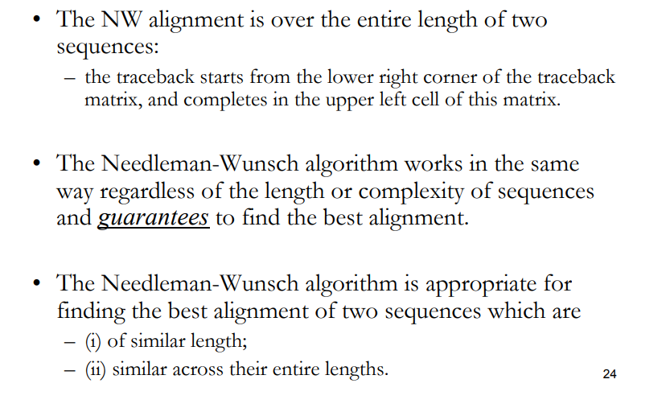
Conclusions
Global score ≤ semi-global score ≤ local score. Discuss !!

Slide 33
Extra slides

Slide 34
Scoring Matrix: Small Example
 | A | R | N | K
A | 5 | -2 | -1 | -1
R | - | 7 | -1 | 3
N | - | - | 7 | 0
K | - | - | - | 6
While R (Arginine) and K (Lysine) are different amino acids, they have a positive score.
Why? They are both positively charged amino acids, and a substitution will not greatly change function of protein.
AKRANR
KAAANK
-1 + (-1) + (-2) + 5 + 7 + 3 = 11

Slide 35
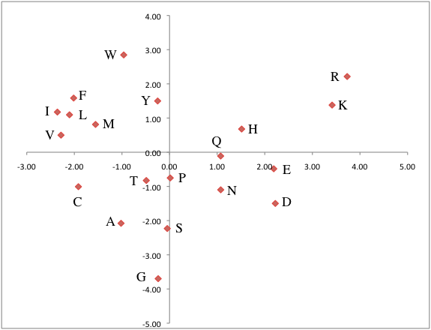
The Blosum50 Scoring Matrix

Slide 36
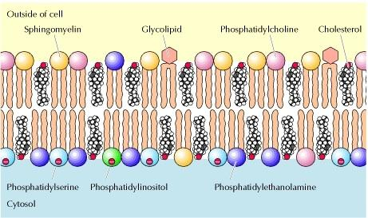
Attributes
Hydrophobic/Hydrophilic
Hydrophobic: repelled by water
Hydrphilic: water soluable
Aromatic / Aliphatic classification of carbon and hydrogen molecules
Aromatic: contain rings, such as benzene rings
Aliphatic: do not contain such rings
Polar: separation of electric charge leading to a electric dipole, or separation of positive and negative charges
The Cell: A molecular Approach
Geoffery Cooper

Slide 37
Conservation
Amino acid changes that tend to preserve the physico-chemical properties of the original residue
Polar to polar
aspartate 🡪 glutamate
Nonpolar to nonpolar
alanine 🡪 valine
Similarly behaving residues
leucine 🡪 isoleucine

Slide 38
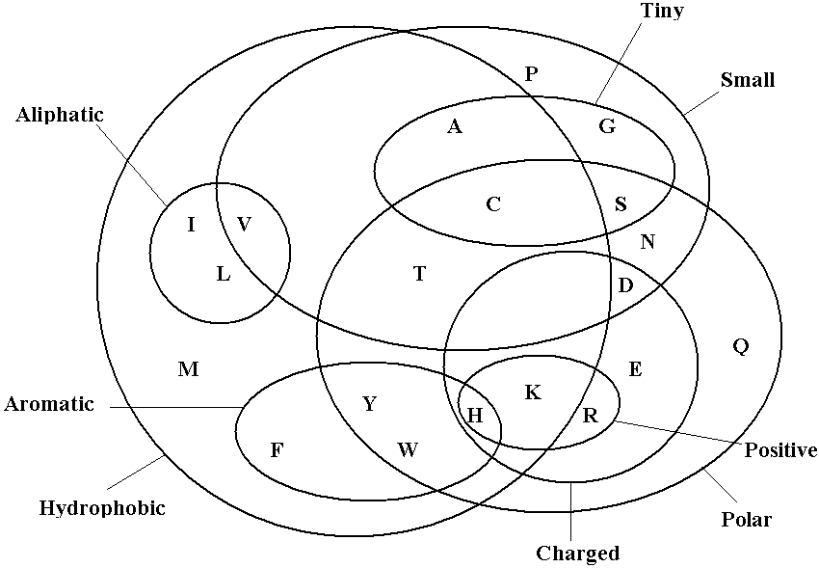

Slide 39
slides adapted from
http://www.cs.otago.ac.nz/cosc348/alignments/Lecture05_GlobalAlignment.pdf
https://demonstrations.wolfram.com/GlobalAndLocalSequenceAlignmentAlgorithms/

